Slide 1
TimeTravelers

Slide 2
Table of contents
01
02
03
Idea
Stack
Team

Slide 3
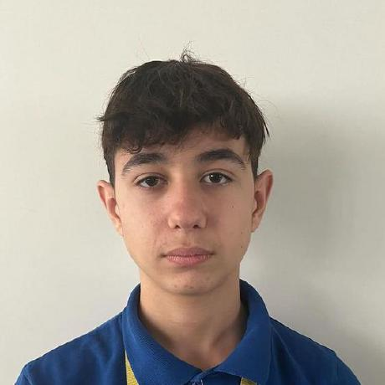
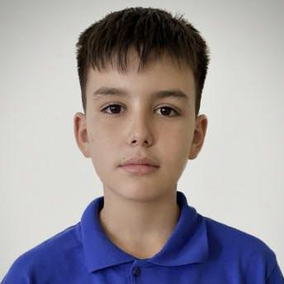
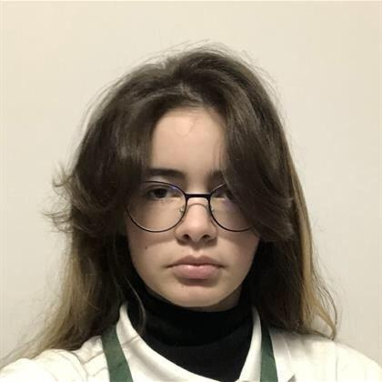
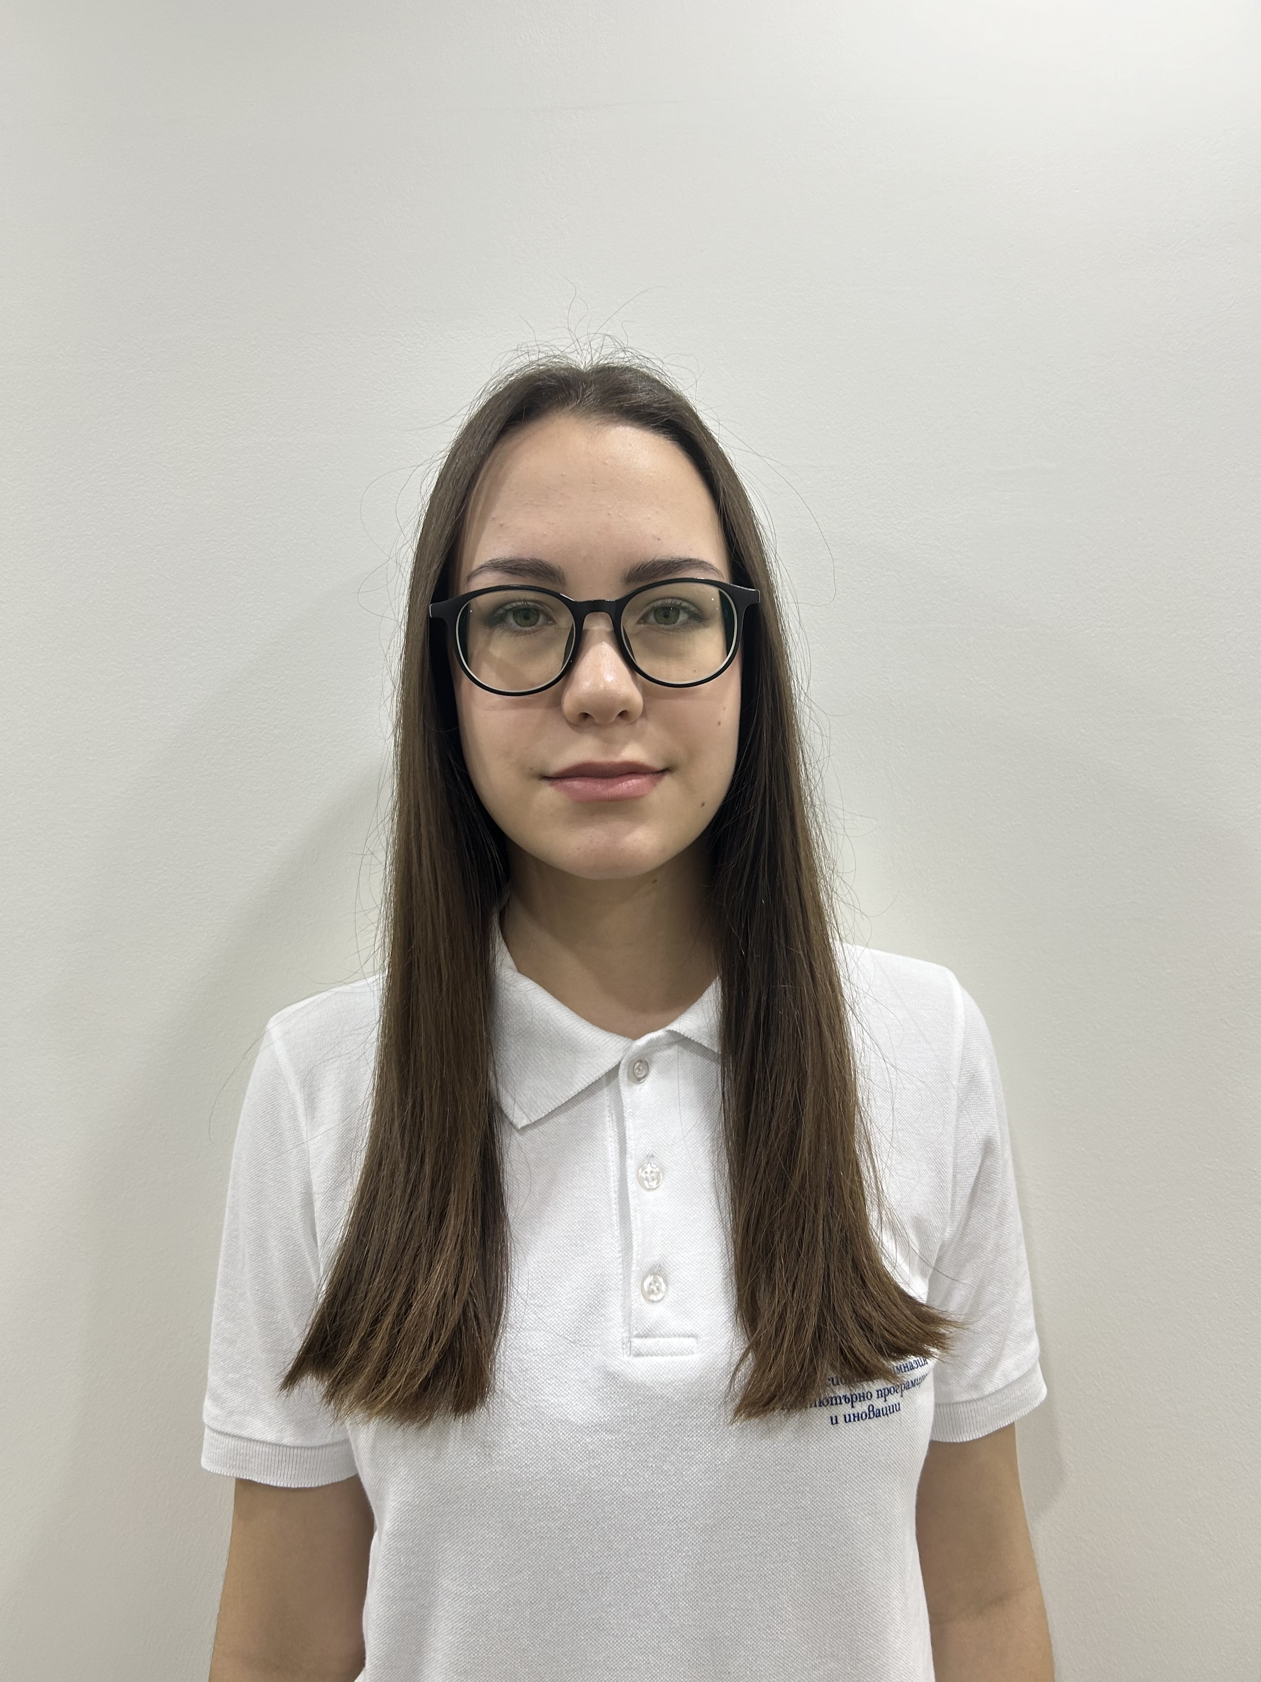
Team
Ani Vezirova – 10G
Frontend/Backend Developer
Stefan Ivanov - 10A
Scrum Trainer
Veselin Boyanov - 10A
Frontend/Backend Developer
Natali Ribareva – 10V
QA

Slide 4


Idea
The core idea behind TimeTravel is to create an interactive way for people—especially students and history enthusiasts—to connect with historical events and figures on a more personal level. Instead of passively reading about the past, users are placed in the role of a time traveler who can explore different eras, alter the flow of events, and engage in conversations with key historical figures.

Slide 5
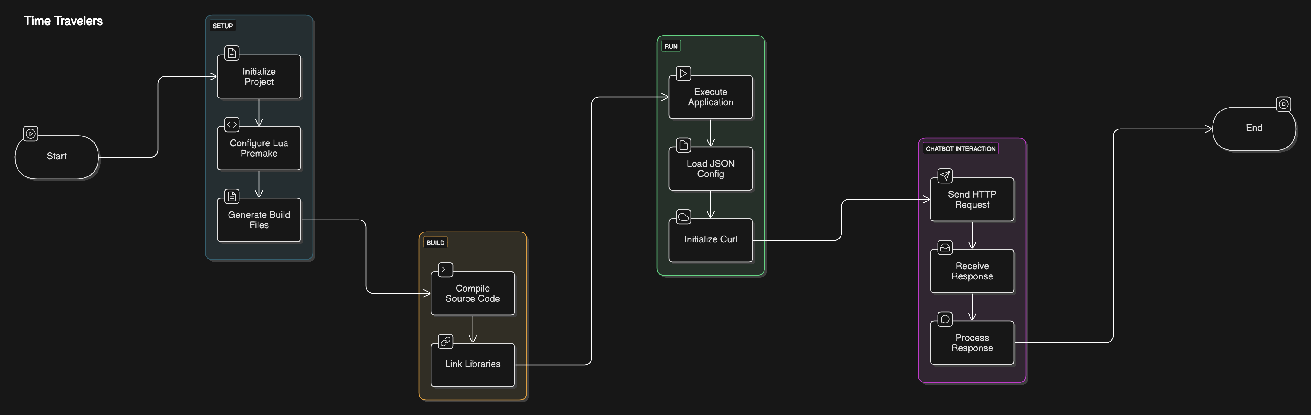
Stack

